Slide 1
Software Engineering
Module: Web UI Programming
Topic: CSS

Slide 2
CSS
The content in this presentation is aimed at teaching learners to:
Describe the parts of CSS rules,
Explain how CSS transforms the HTML tags,
Apply different categories of CSS like
background, text, font, list
Notes:
Instructor Notes:
By the end of this course, participants should be able to:
<Obj1>
<Obj 2>

Slide 3


CSS
Problems of HTML
Intended to define content only. Not intended to contain tags for formatting a document.
Changes to the document is a long and expensive process.
Does not have complete Control Over the formatting of HTML Document.

Slide 4
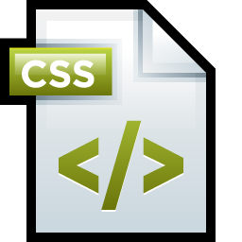
CSS
Problems of HTML
To solve this problem, the World Wide Web Consortium (W3C) created CSS.
Purpose of CSS is to store the format part of HTML document.
All browsers support CSS.

Slide 5
CSS
What is CSS?
CSS (Cascading Style Sheets) is a style sheet used for describing the presentation (the look and formatting) of a document.
Enables the separation of document’s content from document’s presentation, including the elements like, layout, colors, fonts, etc.

Slide 6
CSS
Types of CSS
There are three types of Style Sheets based on their cascading to HTML Documents :
Inline Style Sheet
Internal Style Sheet
External Style Sheet

Slide 7
CSS
Types of CSS
Inline Style Sheet
Placing the css code in the (X)html file along side the element for which you want to define a style.
Example:
<p style="color: #999999;">Some gray text</p>
  Some Gray Text
Note: User cannot change the styles of elements or text formatted in this way.

Slide 8
CSS
Types of CSS
Internal Style Sheet
placing the CSS code within the <head></head> tags of each (X) HTML file.
Example:
<head>
<title><title>
<style type="text/css">
CSS Content Goes Here
</style>
</head>
<body>
Good if we need to define different style for different pages.

Slide 9
CSS
Types of CSS
External Style Sheet
Website does not contain (X)HTML, instead it uses external CSS document.
Save it with the .css file extension.
Need to edit only .css file to make global changes to a website.
Example:
<head>
<title><title>
<link rel="stylesheet“ type="text/css"href="style.css"/>
</head>
<body>

Slide 10
CSS
Comparing Types of CSS
External Style
or
Linking Style
Inline Style
Style.css
Page 1
Page 2
Page 3
Internal Style

Slide 11
CSS
CSS Syntax
Syntax for CSS is different than that of (X) HTML markup
It consists of only 3 parts:
Selector: Is the (X) HTML element for which you want to apply a style.
Property: It is the actual property title.
Value: It is the style you apply to that property.
h1
{ color:white; font-size:20px;}
Selector
Property
Value
Property
Value
Declaration
Declaration

Slide 12
CSS
CSS Syntax
Each selector can have multiple properties and each property within that selector can have independent values.
The property and value are separated with a colon and contained within curly braces.
Multiple properties are separated by a semi colon.
Multiple values within a property are separated by commas.
Individual value containing more than one word should be placed within the double quotes.
div {
background: #eeeeee;
font-family: "Trebuchet MS", Verdana, Arial, serif;
}

Slide 13
CSS
Combining Selectors
Combining Elements within one selector:
h1, h2, h3, h4, h5, h6 {
color: #009900;
font-family: Georgia, sans-serif;
}
All the header elements can be grouped into one selector by using commas to separate each element.

Slide 14
CSS
Comment Tags
Comment Tags are used to explain why you added certain selectors within your CSS file.
Comments that will be ignored by browsers:
/* This is a comment */

Slide 15



CSS
Backgrounds
Property Name | Values | Preview
background-color | color name (yellow) Hexadecimal (#FFFF00) RGB Color Code (rgb(255,255,00)) | Sample text
background-image | url(‘path’) None | Sample Text
background-repeat | repeat (default) | Sample Text
 | repeat-x
 | repeat-y
 | no-repeat
Sample Text
Sample Text
Sample Text

Slide 16
CSS
Backgrounds
Property Name | Values
Background-attachment | Fixed Scroll (default)
Background-position | Center top bottom left right center xy

Slide 17
CSS
Text Properties
Property | Value | Preview
Color | color name (yellow) Hexadecimal (#FFFF00) RGB Color Code (rgb(255,255,00)) | Sample text
text-align | left right center justify | Sample Text Sample Text Sample Text Sample Text

Slide 18
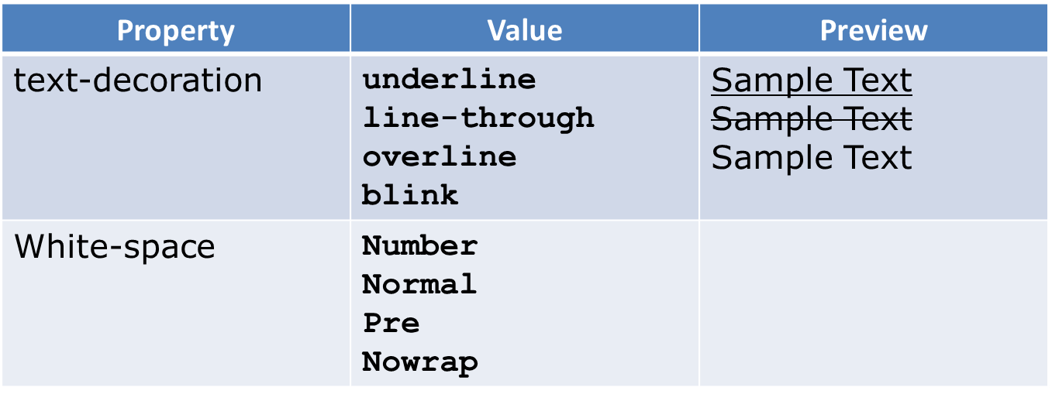
CSS
Text Properties
Sample Text

Slide 19
CSS
Text Properties
Property | Values | Preview
text-transform | None Captalize Lowercase Uppercase | Sample text Sample Text sample text SAMPLE TEXT
Letter-spacing | Number (can be positive and negative) | Sample Text Sample Text
Text-indent | Number Percentage | Sample Text Sample Text Sample Text Sample Te
Line-height | Number Percentage | Sample Text Sample Text Sample Text Sample Text Sample Text Sample Text
Word-spacing | Number Percentage | Sample Text Sample text Sample Text Sample Text Sample Text

Slide 20
CSS
Font Properties
Property | Values | Preview
Font-family | Family-name (arial) Generic-name (arial narrow) | Sample Text
Font-size | xx-large x-large larger large medium small smaller x-small xx-small Length (18) % (percent) | Sample Text xx-large Sample Text x-large Sample Text larger Sample Text large Sample Text medium Sample Text small Sample Text smaller Sample Text x-small Sample Text xx-small Sample Text

Slide 21
CSS
Font Properties
Property | Values | Preview
Font-style | Normal Italic Oblique | Sample Text Sample Text Sample Text
Font-weight | Normal Higher Multiples of 100 up to 900 bolder | Sample Text Sample Text Sample Text Sample Text

Slide 22
CSS
List Style
Property | Values | Preview
List-style-image | url(“path”) | Sample Text Sample Text Sample Text
List-style-position | Inside Outside | Sample Text Sample Text
List-style-type | Disc Circle Square Decimal Lower-roman Upper-roman Lower-alpha Upper-alpha none | Sample Text Sample Text Sample Text 1. Sample Text i. Sample Text I. Sample Text a. Sample Text A. Sample Text Sample Text

Slide 23
CSS
Pseudo Elements
selector:pseudo-element {property: value}
Property | Description
first-line | Adds style to the first line of text in a block level element.
first-letter | Adds style to the first letter of text in a block level element.
p:first-line {font-size: medium; color: #ff0000;}
p:first-letter {font-size: medium; color: #ff0000;}

Slide 24

CSS

